Slide 1


OCP 11 Part 1 [1Z0-819]
Dr.-Ing Mohamed Amine Mezghich
Associate Professor at ENSI, CEO of Smart IT Partner
JAVA/J2EE Certified Trainer
ma.mezghich@smart-it-partner.com
amine.mezghich@ensi-uma.tn

Slide 2
Chapter 1 : Java Building Blocks
OCA EXAM OBJECTIVES COVERED IN THIS CHAPTER(1/2):
✓ Java Basics ■ Define the scope of variables ■ Define the structure of a Java class ■ Create executable Java applications with a main method; run a Java program from the command line; including console output ■ Import other Java packages to make them accessible in your code ■ Compare and contrast the features and components of Java such as platform independence, object orientation, encapsulation, etc.

Slide 3
Chapter 1 : Java Building Blocks
OCA EXAM OBJECTIVES COVERED IN THIS CHAPTER(2/2):
✓ Working with Java Data Types ■ Declare and initialize variables (including casting or primitive types) ■ Differentiate between object reference variables and primitive variables ■ Know how to read or write to object fields ■ Explain an Object’s Lifecycle (creation, “dereference by reassignment” and garbage collection

Slide 4
1-Understanding the Java Class Structure
In Java programs, classes are the basic building blocks. When defining a class, you describe all the parts and characteristics of one of those building blocks.
To use most classes, you have to create objects. An object is a runtime instance of a class in memory. All the various objects of all the different classes represent the state of your program.
In the following sections, we’ll look at fields, methods, and comments. We’ll also explore the relationship between classes and files.

Slide 5
1-Understanding the Java Class Structure
1-1) Fields and Methods
Java classes have two primary elements: methods, often called functions or procedures in other languages, and fields, more generally known as variables. Together these are called the members of the class.
Variables hold the state of the program, and methods operate on that state.
It’s the programmer who creates and arranges these elements in such a way that the resulting code is useful and, ideally, easy for other programmers to understand. Other building blocks include interfaces, which you’ll learn about in Chapter 5, “Class Design,” and Enums, which you’ll learn about when you start studying for the OCP exam.

Slide 6
1-Understanding the Java Class Structure
1-1) Fields and Methods
The simplest Java class you can write looks like this: 1: public class Animal { 2: } Java calls a word with special meaning a keyword. The public keyword on line 1 means the class can be used by other classes. The class keyword indicates you’re defining a class. Animal gives the name of the class. Granted, this isn’t a very interesting class, so add your first field: 1: public class Animal { 2: String name; 3: }

Slide 7
1-Understanding the Java Class Structure
1-1) Fields and Methods
String is also a class supplied with Java. Next you can add methods: 1: public class Animal { 2: String name; 3: public String getName() { 4: return name; 5: } 6: public void setName(String newName) { 7: name = newName; 8: } 9: }

Slide 8
1-Understanding the Java Class Structure
1-1) Fields and Methods
On lines 3–5, you’ve defned your frst method. A method is an operation that can be called. Again, public is used to signify that this method may be called from other classes. Next comes the return type—in this case, the method returns a String. On lines 6–8 is another method. This one has a special return type called void. void means that no value at all is returned.
This method requires information be supplied to it from the calling method; this information is called a parameter. setName has one parameter named newName, and it is of type String. This means the caller should pass in one String parameter and expect nothing to be returned.

Slide 9
1-Understanding the Java Class Structure
1-1) Fields and Methods
The full declaration of a method is called a method signature. In this example, can you identify the return type and parameters? public int numberVisitors(int month)
The return type is int, which is a numeric type. There’s one parameter named month, which is of type int as well.

Slide 10
1-Understanding the Java Class Structure
1-2) Comments There are three types of comments in Java. The frst is called a single-line comment: // comment until end of line A single-line comment begins with two slashes. Anything you type after that on the same line is ignored by the compiler. Next comes the multiple-line comment: /* Multiple * line comment */ A multiple-line comment (also known as a multiline comment) includes anything starting from the symbol /* until the symbol */. People often type an asterisk (*) at the beginning of each line of a multiline comment to make it easier to read, but you don’t have to.

Slide 11
1-Understanding the Java Class Structure
1-2) Comments Finally, we have a Javadoc comment: /** * Javadoc multiple-line comment * @author Jeanne and Scott */ This comment is similar to a multiline comment except it starts with /**. This special syntax tells the Javadoc tool to pay attention to the comment. Javadoc comments have a specifc structure that the Javadoc tool knows how to read. You won’t see a Javadoc comment on the exam—just remember it exists so you can read up on it online when you start writing programs for others to use.

Slide 12
1-Understanding the Java Class Structure
1-3) Classes vs. Files Most of the time, each Java class is defined in its own *.java file. It is usually public, which means any code can call it. Interestingly, Java does not require that the class be public. For example, this class is just fine: 1: class Animal { 2: String name; 3: }

Slide 13
1-Understanding the Java Class Structure
1-3) Classes vs. Files You can even put two classes in the same file. When you do so, at most one of the classes in the file is allowed to be public. That means a file containing the following is also fine: 1: public class Animal { 2: private String name; 3: } 4: class Animal2 { 5: } If you do have a public class, it needs to match the filename. public class Animal2 would not compile in a file named Animal.java.

Slide 14
2-Writing a main() Method
A Java program begins execution with its main() method. A main() method is the gateway between the startup of a Java process, which is managed by the Java Virtual Machine (JVM), and the beginning of the programmer’s code. The JVM calls on the underlying system to allocate memory and CPU time, access files, and so on.
The main() method lets us hook our code into this process, keeping it alive long enough to do the work we’ve coded. The simplest possible class with a main() method looks like this: 1: public class Zoo { 2: public static void main(String[] args) { 3: 4: } 5:}

Slide 15
2-Writing a main() Method
This code doesn’t do anything useful (or harmful). It has no instructions other than to declare the entry point. It does illustrate, in a sense, that what you can put in a main() method is arbitrary. Any legal Java code will do. In fact, the only reason we even need a class structure to start a Java program is because the language requires it. To compile and execute this code, type it into a file called Zoo.java and execute the following: $ javac Zoo.java $ java Zoo

Slide 16
2-Writing a main() Method
To compile Java code, the file must have the extension .java. The name of the file must match the name of the class. The result is a file of bytecode by the same name, but with a .class filename extension. Bytecode consists of instructions that the JVM knows how to execute. Notice that we must omit the .class extension to run Zoo.java
Some rules :
-Each file can contain only one class. -The filename must match the class name, including case, and have a .java extension.

Slide 17
2-Writing a main() Method
We arrive at the main() method’s parameter list, represented as an array of java. lang.String objects. In practice, you can write String[] args, String args[] or String...args; the compiler accepts any of these.
The variable name args hints that this list contains values that were read in (arguments) when the JVM started. You can use any name you like, though. The characters [] are brackets and represent an array. An array is a fixed-size list of items that are all of the same type. The characters ... are called varargs (variable argument lists).
You will learn about String in Chapter 2, “Operators and Statements.” Arrays and varargs will follow in Chapter 3, “Core Java APIs.”

Slide 18
2-Writing a main() Method
Let’s see how to use the args parameter. First we modify the Zoo program to print out the first two arguments passed in: public class Zoo { public static void main(String[] args) { System.out.println(args[0]); System.out.println(args[1]); } }

Slide 19
2-Writing a main() Method
public class Zoo { public static void main(String[] args) { System.out.println(args[0]); System.out.println(args[1]); } } args[0] accesses the frst element of the array. That’s right: array indexes begin with 0 in Java. To run it, type this: $ javac Zoo.java $ java Zoo Bronx Zoo

Slide 20
2-Writing a main() Method
The output is what you might expect: Bronx Zoo The program correctly identifes the frst two “words” as the arguments. Spaces are used to separate the arguments. If you want spaces inside an argument, you need to use quotes as in this example: $ javac Zoo.java $ java Zoo "San Diego" Zoo Now we have a space in the output: San Diego Zoo

Slide 21
2-Writing a main() Method
No matter. You still get the values output as Strings. In Chapter 2, you’ll learn how to convert Strings to numbers. Zoo 2 Finally, what happens if you don’t pass in enough arguments? $ javac Zoo.java $ java Zoo Zoo

Slide 22
2-Writing a main() Method
Reading args[0] goes fine and Zoo is printed out. Then Java panics. There’s no second argument! What to do? Java prints out an exception telling you it has no idea what to do with this argument at position 1. (You’ll learn about exceptions in Chapter 6, “Exceptions.”) ZooException in thread "main“ java.lang.ArrayIndexOutOfBoundsException: 1 at mainmethod.Zoo.main(Zoo.java:7)
To review, you need to have a JDK to compile because it includes a compiler. You do not need to have a JDK to run the code—a JRE is enough. Java class fles run on the JVM and therefore run on any machine with Java rather than just the machine or operating system they happened to have been compiled on.

Slide 23
3-Understanding Package Declarations and Imports
Java comes with thousands of built-in classes, and there are countless more from developers like you. With all those classes, Java needs a way to organize them. It handles this in a way similar to a fle cabinet.
You put all your pieces of paper in folders. Java puts classes in packages. These are logical groupings for classes.
We wouldn’t put you in front of a file cabinet and tell you to find a specific paper. Instead, we’d tell you which folder to look in. Java works the same way. It needs you have to tell it which packages to look in to find code.

Slide 24
3-Understanding Package Declarations and Imports
Suppose you try to compile this code: public class ImportExample { public static void main(String[] args) { Random r = new Random(); // DOES NOT COMPILE System.out.println(r.nextInt(10)); } } The Java compiler helpfully gives you an error that looks like this: Random cannot be resolved to a type

Slide 25
3-Understanding Package Declarations and Imports
Trying this again with the import allows you to compile:
import java.util.Random; // import tells us where to find Random public class ImportExample { public static void main(String[] args) { Random r = new Random(); System.out.println(r.nextInt(10)); // print a number between 0 and 9 } }

Slide 26
3-Understanding Package Declarations and Imports
3-1) Wildcards Classes in the same package are often imported together. You can use a shortcut to import all the classes in a package: import java.util.*; // imports java.util.Random among other things public class ImportExample { public static void main(String[] args) { Random r = new Random(); System.out.println(r.nextInt(10)); } }

Slide 27
3-Understanding Package Declarations and Imports
3-1) Wildcards In this example, we imported java.util.Random and a pile of other classes. The * is a wildcard that matches all classes in the package. Every class in the java.util package is available to this program when Java compiles it. It doesn’t import child packages, fields, or methods; it imports only classes. (Okay, it’s only classes for now, but there’s a special type of import called the “static import” that imports other types. You’ll learn more about that in Chapter 4.)
- You might think that including so many classes slows down your program, but it doesn’t. The compiler figures out what’s actually needed. Which approach you choose is personal preference. - Listing the classes used makes the code easier to read, especially for new programmers. Using the wildcard can shorten the import list. You’ll see both approaches on the exam.

Slide 28
3-Understanding Package Declarations and Imports
3-2) Redundant Imports Wait a minute! We’ve been referring to System without an import and Java found it just fine. There’s one special package in the Java world called java.lang. This package is special in that it is automatically imported.
You can still type this package in an import statement, but you don’t have to. In the following code, how many of the imports do you think are redundant?

Slide 29
3-Understanding Package Declarations and Imports
3-2) Redundant Imports 1: import java.lang.System; 2: import java.lang.*; 3: import java.util.Random; 4: import java.util.*; 5: public class ImportExample { 6: public static void main(String[] args) { 7: Random r = new Random(); 8: System.out.println(r.nextInt(10)); 9: } 10: }

Slide 30
3-Understanding Package Declarations and Imports
3-2) Redundant Imports The answer is that three of the imports are redundant. Lines 1 and 2 are redundant because everything in java.lang is automatically considered to be imported. Line 4 is also redundant in this example because Random is already imported from java.util.Random. If line 3 wasn’t present, java.util.* wouldn’t be redundant, though, since it would cover importing Random. Another case of redundancy involves importing a class that is in the same package as the class importing it. Java automatically looks in the current package for other classes.

Slide 31
3-Understanding Package Declarations and Imports
3-2) Redundant Imports Let’s take a look at one more example to make sure you understand the edge cases for imports. For this example, Files and Paths are both in the package java.nio.file. You don’t need to memorize this package for the OCA exam (but you should know it for the OCP exam).
When testing your understanding of packages and imports, the OCA exam will use packages you may never have seen before. The question will let you know which package the class is in if you need to know that in order to answer the question.

Slide 32
3-Understanding Package Declarations and Imports
3-2) Redundant Imports What imports do you think would work to get this code to compile? public class InputImports { public void read(Files files) { Paths.get("name"); } } There are two possible answers. The shorter one is to use a wildcard to import both at the same time: import java.nio.file.*; The other answer is to import both classes explicitly: import java.nio.file.Files; import java.nio.file.Paths;

Slide 33
3-Understanding Package Declarations and Imports
3-3) Naming Conflicts One of the reasons for using packages is so that class names don’t have to be unique across all of Java. This means you’ll sometimes want to import a class that can be found in multiple places.
A common example of this is the Date class. Java provides implementations of java.util.Date and java.sql.Date. This is another example where you don’t need to know the package names for the OCA exam—they will be provided to you. What import could we use if we want the java.util.Date version?

Slide 34
3-Understanding Package Declarations and Imports
3-3) Naming Conflicts
public class Conflicts { Date date; // some more code } The answer should be easy by now. You can write either import java.util.*; or import java.util.Date;. The tricky cases come about when other imports are present:

Slide 35
3-Understanding Package Declarations and Imports
3-3) Naming Conflicts
import java.util.*; import java.sql.*; // DOES NOT COMPILE When the class is found in multiple packages, Java gives you the compiler error:
The type Date is ambiguous
In our example, the solution is easy—remove the java.sql.Date import that we don’t need. But what do we do if we need a whole pile of other classes in the java.sql package? import java.util.Date; import java.sql.*;

Slide 36
3-Understanding Package Declarations and Imports
3-3) Naming Conflicts
Ah, now it works. If you explicitly import a class name, it takes precedence over any wildcards present. Java thinks, “Okay! The programmer really wants me to assume use of the java.util.Date class.” One more example. What does Java do with “ties” for precedence? import java.util.Date; import java.sql.Date;

Slide 37
3-Understanding Package Declarations and Imports
3-3) Naming Conflicts
Java is smart enough to detect that this code is no good. As a programmer, you’ve claimed to explicitly want the default to be both the java.util.Date and java.sql.Date implementations. Because there can’t be two defaults, the compiler tells you: The import java.sql.Date collides with another import statement

Slide 38
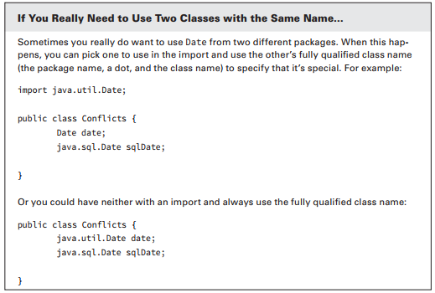
3-Understanding Package Declarations and Imports
3-3) Naming Conflicts

Slide 39
3-Understanding Package Declarations and Imports
3-4) Creating a New Package
In real life, always name your packages to avoid naming conﬂicts and to allow others to reuse your code.
Now it’s time to create a new package. The directory structure on your computer is related to the package name. Suppose we have these two classes:

Slide 40
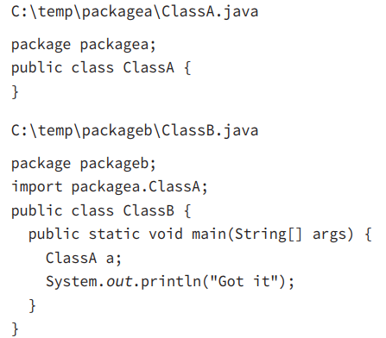
3-Understanding Package Declarations and Imports
3-4) Creating a New Package
When you run a Java program, Java knows where to look for those package names. In this case, running from C:\temp works because both packagea and packageb are underneath it.

Slide 41
4-Creating Objects
4-1) Constructors To create an instance of a class, all you have to do is write new before it. For example: Random r = new Random(); First you declare the type that you’ll be creating (Random) and give the variable a name (r). This gives Java a place to store a reference to the object. Then you write new Random() to actually create the object. Random() looks like a method since it is followed by parentheses. It’s called a constructor, which is a special type of method that creates a new object. Now it’s time to define a constructor of your own: public class Chick { public Chick() { System.out.println("in constructor"); } }

Slide 42
4-Creating Objects
4-1) Constructors There are two key points to note about the constructor: the name of the constructor matches the name of the class, and there’s no return type. You’ll likely see a method like this on the exam: public void Chick() { } // NOT A CONSTRUCTOR
When you see a method name beginning with a capital letter and having a return type, pay special attention to it. It is not a constructor since there’s a return type. It’s a regular method that won’t be called when you write new Chick().

Slide 43
4-Creating Objects
4-1) Constructors The purpose of a constructor is to initialize fields, although you can put any code in there. Another way to initialize fields is to do so directly on the line on which they’re declared. This example shows both approaches: public class Chicken { int numEggs = 0;// initialize on line String name; public Chicken() { name = "Duke";// initialize in constructor } }

Slide 44
4-Creating Objects
4-2) Reading and Writing Object Fields It’s possible to read and write instance variables directly from the caller. In this example, a mother swan lays eggs: public class Swan { int numberEggs;// instance variable public static void main(String[] args) { Swan mother = new Swan(); mother.numberEggs = 1; // set variable System.out.println(mother.numberEggs); // read variable } }

Slide 45
4-Creating Objects
4-2) Reading and Writing Object Fields Reading a variable is known as getting it. The class gets numberEggs directly to print it out. Writing to a variable is known as setting it. This class sets numberEggs to 1. In Chapter 4, you’ll learn how to protect the Swan class from having someone set a negative number of eggs. You can even read and write fields directly on the line declaring them: 1: public class Name { 2: String first = "Theodore"; 3: String last = "Moose"; 4: String full = first + last; 5: { Lines 2 and 3 both write to felds. Line 4 does both. It reads the fields first and last. It then writes the field full.

Slide 46
4-Creating Objects
4-3) Instance Initializer Blocks When you learned about methods, you saw braces ({}). The code between the braces is called a code block. Sometimes this code is called being inside the braces. Anywhere you see braces is a code block. Sometimes code blocks are inside a method. These are run when the method is called. Other times, code blocks appear outside a method. These are called instance initializers. In Chapter 5, you’ll learn how to use a static initializer.

Slide 47
4-Creating Objects
4-3) Instance Initializer Blocks How many blocks do you see in this example? How many instance initializers do you see? 3: public static void main(String[] args) { 4: { System.out.println("Feathers"); } 5: } 6: { System.out.println("Snowy"); }

Slide 48
4-Creating Objects
4-3) Instance Initializer Blocks
There are three code blocks and one instance initializer. Counting code blocks is easy: you just count the number of pairs of braces. If there aren’t the same number of open ({) and close (}) braces, the code doesn’t compile. It doesn’t matter that one set of braces is inside the main() method—it still counts.
When counting instance initializers, keep in mind that it does matter whether the braces are inside a method. There’s only one pair of braces outside a method. Line 6 is an instance initializer.

Slide 49
4-Creating Objects
4-4) Order of Initialization When writing code that initializes fields in multiple places, you have to keep track of the order of initialization. We’ll add some more rules to the order of initialization in Chapters 4 and 5. In the meantime, you need to remember: ■ Fields and instance initializer blocks are run in the order in which they appear in the file. ■ The constructor runs after all fields and instance initializer blocks have run.

Slide 50
4-Creating Objects
Running this example prints this: setting field setting constructor Tiny
Let’s look at what’s happening here. We start with the main() method because that’s where Java starts execution. On line 9, we call the constructor of Chick. Java creates a new object. First it initializes name to "Fluffy" on line 2. Next it executes the print statement in the instance initializer on line 3. Once all the fields and instance initializers have run, Java returns to the constructor. Line 5 changes the value of name to "Tiny" and line 6 prints another statement. At this point, the constructor is done executing and goes back to the print statement on line 10.
4-4) Order of Initialization Let’s look at an example: 1: public class Chick { 2: private String name = "Fluffy"; 3: { System.out.println("setting field"); } 4: public Chick() { 5: name = "Tiny"; 6: System.out.println("setting constructor"); 7: } 8: public static void main(String[] args) { 9: Chick chick = new Chick(); 10: System.out.println(chick.name); } }

Slide 51
4-Creating Objects
4-4) Order of Initialization Order matters for the fields and blocks of code. You can’t refer to a variable before it has been initialized: { System.out.println(name); } // DOES NOT COMPILE private String name = "Fluffy"; You should expect to see a question about initialization on the exam. Let’s try one more. What do you think this code prints out?

Slide 52
4-Creating Objects
4-4) Order of Initialization public class Egg { public Egg() { number = 5; } public static void main(String[] args) { Egg egg = new Egg(); System.out.println(egg.number); } private int number = 3; { number = 4; } }
If you answered 5, you got it right.
Fields and blocks are run first in order, setting number to 3 and then 4.
Then the constructor runs, setting number to 5.

Slide 53
5-Distinguishing Between Object References and Primitives
Java applications contain two types of data: primitive types and reference types. In this section, we’ll discuss the differences between a primitive type and a reference type.
5-1) Primitive Types Java has eight built-in data types, referred to as the Java primitive types. These eight data types represent the building blocks for Java objects, because all Java objects are just a complex collection of these primitive data types. The exam assumes you are well versed in the eight primitive data types, their relative sizes, and what can be stored in them.

Slide 54
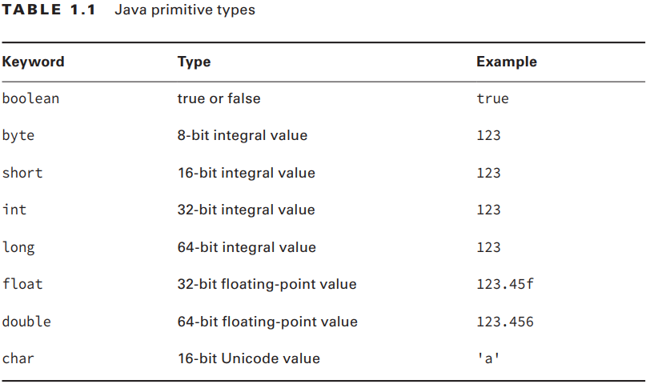
5-Distinguishing Between Object References and Primitives
5-1) Primitive Types Table 1.1 shows the Java primitive types together with their size in bytes and the range of values that each holds.
Notes:
A float requires the letter f following the number so Java knows it is a float.

Slide 55
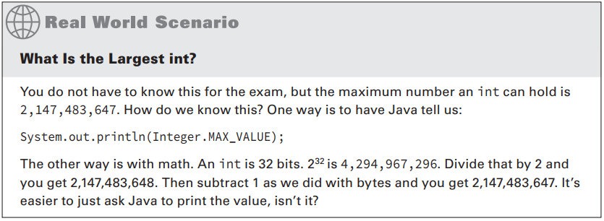
5-Distinguishing Between Object References and Primitives
5-1) Primitive Types
Notes:
A float requires the letter f following the number so Java knows it is a float.

Slide 56
5-Distinguishing Between Object References and Primitives
5-1) Primitive Types There are a few more things you should know about numeric primitives. When a number is present in the code, it is called a literal. By default, Java assumes you are defining an int value with a literal. In this example, the number listed is bigger than what fits in an int. Remember, you aren’t expected to memorize the maximum value for an int. The exam will include it in the question if it comes up. long max = 3123456789; // DOES NOT COMPILE Java complains the number is out of range. And it is—for an int. However, we don’t have an int. The solution is to add the character L to the number: long max = 3123456789L; // now Java knows it is a long Alternatively, you could add a lowercase l to the number. But please use the uppercase L. The lowercase l looks like the number 1.
Notes:
A float requires the letter f following the number so Java knows it is a float.

Slide 57
5-Distinguishing Between Object References and Primitives
5-1) Primitive Types Another way to specify numbers is to change the “base.” When you learned how to count, you studied the digits 0–9. This numbering system is called base 10 since there are 10 numbers. It is also known as the decimal number system. Java allows you to specify digits in several other formats: ■ octal (digits 0–7), which uses the number 0 as a prefix—for example, 017 ■ hexadecimal (digits 0–9 and letters A–F), which uses the number 0 followed by x or X as a prefix—for example, 0xFF ■ binary (digits 0–1), which uses the number 0 followed by b or B as a prefix—for example, 0b10 You won’t need to convert between number systems on the exam. You’ll have to recognize valid literal values that can be assigned to numbers.
Notes:
A float requires the letter f following the number so Java knows it is a float.

Slide 58
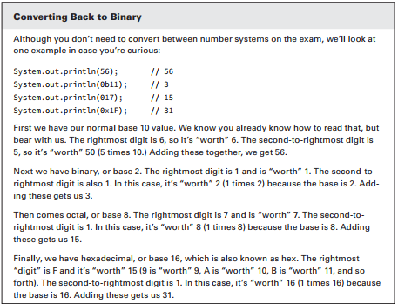
5-Distinguishing Between Object References and Primitives
5-1) Primitive Types
Notes:
A float requires the letter f following the number so Java knows it is a float.

Slide 59
5-Distinguishing Between Object References and Primitives
5-1) Primitive Types The last thing you need to know about numeric literals is a feature added in Java 7. You can have underscores in numbers to make them easier to read: int million1 = 1000000; int million2 = 1_000_000; We’d rather be reading the latter one because the zeroes don’t run together. You can add underscores anywhere except at the beginning of a literal, the end of a literal, right before a decimal point, or right after a decimal point.
Notes:
A float requires the letter f following the number so Java knows it is a float.

Slide 60
5-Distinguishing Between Object References and Primitives
5-1) Primitive Types Let’s look at a few examples:
double notAtStart = _1000.00; // DOES NOT COMPILE double notAtEnd = 1000.00_; // DOES NOT COMPILE double notByDecimal = 1000_.00; // DOES NOT COMPILE double annoyingButLegal = 1_00_0.0_0; // this one compiles
Notes:
A float requires the letter f following the number so Java knows it is a float.

Slide 61
5-Distinguishing Between Object References and Primitives
5-2) Reference Types
A reference type refers to an object (an instance of a class). Unlike primitive types that hold their values in the memory where the variable is allocated, references do not hold the value of the object they refer to.
Instead, a reference “points” to an object by storing the memory address where the object is located, a concept referred to as a pointer. Unlike other languages, Java does not allow you to learn what the physical memory address is. You can only use the reference to refer to the object.

Slide 62
5-Distinguishing Between Object References and Primitives
5-2) Reference Types
Let’s take a look at some examples that declare and initialize reference types. Suppose we declare a reference of type java.util.Date and a reference of type String: java.util.Date today; String greeting; A value is assigned to a reference in one of two ways: ■ A reference can be assigned to another object of the same type. ■ A reference can be assigned to a new object using the new keyword.

Slide 63
5-Distinguishing Between Object References and Primitives
5-2) Reference Types
For example, the following statements assign these references to new objects: today = new java.util.Date(); greeting = "How are you?"; The String and Date objects do not have names and can be accessed only via their corresponding reference. Figure 1.1 shows how the reference types appear in memory.

Slide 64
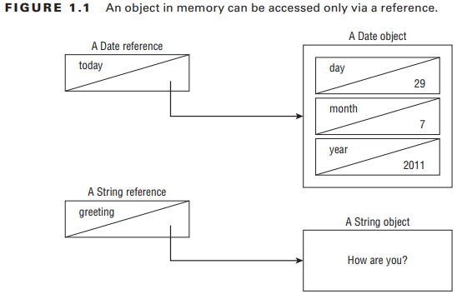
5-Distinguishing Between Object References and Primitives
5-2) Reference Types
There are a few important differences you should know between primitives and reference types.
1) First, reference types can be assigned null, which means they do not currently refer to an object. Primitive types will give you a compiler error if you attempt to assign them null. In this example, value cannot point to null because it is of type int: int value = null; // DOES NOT COMPILE String s = null;

Slide 65
5-Distinguishing Between Object References and Primitives
5-2) Reference Types
2) Next, reference types can be used to call methods when they do not point to null. Primitives do not have methods declared on them. In this example, we can call a method on reference since it is of a reference type. You can tell length is a method because it has () after it. The following line is gibberish. No methods exist on len because it is an int primitive. Primitives do not have methods. String reference = "hello"; int len = reference.length(); int bad = len.length(); // DOES NOT COMPILE 3) Finally, notice that all the primitive types have lowercase type names. All classes that come with Java begin with uppercase. You should follow this convention for classes you create as well.

Slide 66
6-Declaring and Initializing Variables
6-1) Declaring Multiple Variables How many variables do you think are declared and initialized in the following two lines? String s1, s2; String s3 = "yes", s4 = "no"; Four String variables were declared: s1, s2, s3, and s4. You can declare many variables in the same declaration as long as they are all of the same type. You can also initialize any or all of those values inline. In the previous example, we have two initialized variables: s3 and s4. The other two variables remain declared but not yet initialized.
Another way the exam could try to trick you is to show you code like this line: int num, String value; // DOES NOT COMPILE
Notes:
This code doesn’t compile because it tries to declare multiple variables of different types in the same statement. The shortcut to declare multiple variables in the same statement only works when they share a type.

Slide 67
6-Declaring and Initializing Variables
6-1) Declaring Multiple Variables To make sure you understand this, see if you can figure out which of the following are legal declarations. “Legal,” “valid,” and “compiles” are all synonyms in the Java exam world. We try to use all the terminology you could encounter on the exam.
boolean b1, b2; String s1 = "1", s2; double d1, double d2; int i1; int i2; int i3; i4;
The third statement is not legal. Java does not allow you to declare
two different types in the same statement. Wait a minute!
Variables d1 and d2 are the same type. They are both of type double.
Although that’s true, it still isn’t allowed. If you want to declare multiple variables in the same statement, they must share the same type declaration
and not repeat it. double d1, d2; would have been legal.
The fifth statement is not legal. Again, we have two completely different
statements on the same line.
Notes:
This code doesn’t compile because it tries to declare multiple variables of different types in the same statement. The shortcut to declare multiple variables in the same statement only works when they share a type.

Slide 68
6-Declaring and Initializing Variables
6-2) Identifiers It probably comes as no surprise that Java has precise rules about identifer names. Luckily, the same rules for identifers apply to anything you are free to name, including variables, methods, classes, and felds. There are only three rules to remember for legal identifers: ■ The name must begin with a letter or the symbol $ or _. ■ Subsequent characters may also be numbers. ■ You cannot use the same name as a Java reserved word. As you might imagine, a reserved word is a keyword that Java has reserved so that you are not allowed to use it. Remember that Java is case sensitive, so you can use versions of the keywords that only differ in case.

Slide 69
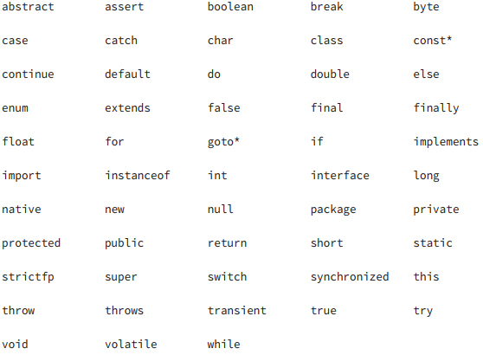
6-Declaring and Initializing Variables
6-2) Identifiers
Prepare to be tested on these rules.
okidentifier $OK2Identifier _alsoOK1d3ntifi3r __SStillOkbutKnotsonice$
3DPointClass // identifiers cannot begin with a number hollywood@vine // @ is not a letter, digit, $ or _ *$coffee // * is not a letter, digit, $ or _ public // public is a reserved word

Slide 70
7-Understanding Default Initialization of Variables
Before you can use a variable, it needs a value. Some types of variables get this value set automatically, and others require the programmer to specify it. In the following sections, we’ll look at the differences between the defaults for local, instance, and class variables.

Slide 71
7-Understanding Default Initialization of Variables
7-1) Local Variables A local variable is a variable defned within a method. Local variables must be initialized before use. They do not have a default value and contain garbage data until initialized. The compiler will not let you read an uninitialized value. For example, the following code generates a compiler error: 4: public int notValid() { 5: int y = 10; 6: int x; 7: int reply = x + y; // DOES NOT COMPILE 8: return reply; 9: }

Slide 72
7-Understanding Default Initialization of Variables
7-1) Local Variables The compiler is also smart enough to recognize initializations that are more complex. In this example, there are two branches of code. answer is initialized in both of them so the compiler is perfectly happy. onlyOneBranch is only initialized if check happens to be true. The compiler knows there is the possibility for check to be false, resulting in uninitialized code, and gives a compiler error. You’ll learn more about the if statement in the next chapter.

Slide 73
7-Understanding Default Initialization of Variables
7-1) Local Variables public void findAnswer(boolean check) { int answer; int onlyOneBranch; if (check) { onlyOneBranch = 1; answer = 1; } else { answer = 2; } System.out.println(answer); System.out.println(onlyOneBranch); // DOES NOT COMPILE }

Slide 74
7-Understanding Default Initialization of Variables
7-2) Instance and Class Variables Variables that are not local variables are known as instance variables or class variables. Instance variables are also called fields. Class variables are shared across multiple objects. You can tell a variable is a class variable because it has the keyword static before it. You’ll learn about this in Chapter 4. For now, just know that a variable is a class variable if it has the static keyword in its declaration. Instance and class variables do not require you to initialize them. As soon as you declare these variables, they are given a default value. You’ll need to memorize everything in table 1.2 except the default value of char. To make this easier, remember that the compiler doesn’t know what value to use and so wants the simplest type it can give the value: null for an object and 0/false for a primitive.

Slide 75
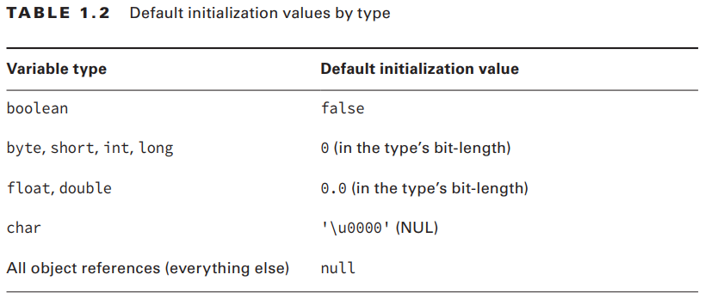
7-Understanding Default Initialization of Variables
7-2) Instance and Class Variables

Slide 76
8-Understanding Variable Scope
You’ve learned that local variables are declared within a method. How many local variables do you see in this example? public void eat(int piecesOfCheese) { int bitesOfCheese = 1; }
There are two local variables in this method. bitesOfCheese is declared inside the method. piecesOfCheese is called a method parameter. It is also local to the method. Both of these variables are said to have a scope local to the method. This means they cannot be used outside the method.

Slide 77
8-Understanding Variable Scope
Local variables can never have a scope larger than the method they are defined in. However, they can have a smaller scope. Consider this example:
3: public void eatIfHungry(boolean hungry) { 4: if (hungry) { 5: int bitesOfCheese = 1; 6: } // bitesOfCheese goes out of scope here 7: System.out.println(bitesOfCheese);// DOES NOT COMPILE 8: }

Slide 78
8-Understanding Variable Scope
hungry has a scope of the entire method. bitesOfCheese has a smaller scope. It is only available for use in the if statement because it is declared inside of it. When you see a set of braces ({ }) in the code, it means you have entered a new block of code. Each block of code has its own scope. When there are multiple blocks, you match them from the inside out. In our case, the if statement block begins at line 4 and ends at line 6. The method’s block begins at line 3 and ends at line 8. Since bitesOfCheese is declared in such a block, the scope is limited to that block. When the compiler gets to line 7, it complains that it doesn’t know anything about this bitesOfCheese thing and gives an error:

Slide 79
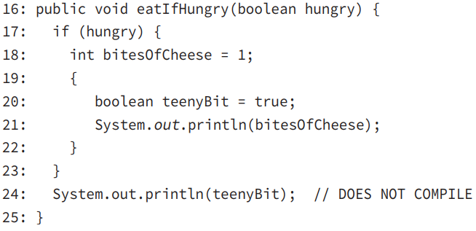
8-Understanding Variable Scope
Remember that blocks can contain other blocks. These smaller contained blocks can reference variables defned in the larger scoped blocks, but not vice versa. For example:

Slide 80
8-Understanding Variable Scope
See if you can figure out on which line each of the five local variables goes into and out of scope:
11: public void eatMore(boolean hungry, int amountOfFood) { 12: int roomInBelly = 5; 13: if (hungry) { 14: boolean timeToEat = true; 15: while (amountOfFood > 0) { 16: int amountEaten = 2; 17: roomInBelly = roomInBelly - amountEaten; 18: amountOfFood = amountOfFood - amountEaten; 19: } 20: } 21: System.out.println(amountOfFood); 22: }

Slide 81
8-Understanding Variable Scope
8-1) Instance and Class Variables
All that was for local variables. Luckily the rule for instance variables is easier: they are available as soon as they are defined and last for the entire lifetime of the object itself.
The rule for class (static) variables is even easier: they go into scope when declared like the other variables types. However, they stay in scope for the entire life of the program.

Slide 82
8-Understanding Variable Scope
8-1) Instance and Class Variables
Let’s do one more example to make sure you have a handle on this. Again, try to figure out the type of the four variables and when they go into and out of scope.

Slide 83
8-Understanding Variable Scope
In this class, we have one class variable (MAX_LENGTH), one instance variable (length), and two local variables (inches and newSize.) MAX_LENGTH is a class variable because it has the static keyword in its declaration. MAX_LENGTH goes into scope on line 2 where it is declared. It stays in scope until the program ends. length goes into scope on line 3 where it is declared. It stays in scope as long as this Mouse object exists. inches goes into scope where it is declared on line 4. It goes out of scope at the end of the method on line 9. newSize goes into scope where it is declared on line 6. Since it is defned inside the if statement block, it goes out of scope when that block ends on line 8
8-1) Instance and Class Variables 1: public class Mouse { 2: static int MAX_LENGTH = 5; 3: int length; 4: public void grow(int inches) { 5: if (length < MAX_LENGTH) { 6: int newSize = length + inches; 7: length = newSize; 8: } 9: } 10: }

Slide 84
8-Understanding Variable Scope
8-1) Instance and Class Variables Got all that? Let’s review the rules on scope: ■ Local variables—in scope from declaration to end of block ■ Instance variables—in scope from declaration until object garbage collected ■ Class variables—in scope from declaration until program ends

Slide 85
9-Ordering Elements in a Class
Now that you’ve seen the most common parts of a class, let’s take a look at the correct order to type them into a file. Comments can go anywhere in the code. Beyond that, you need to memorize the rules in Table 1.4.

Slide 86
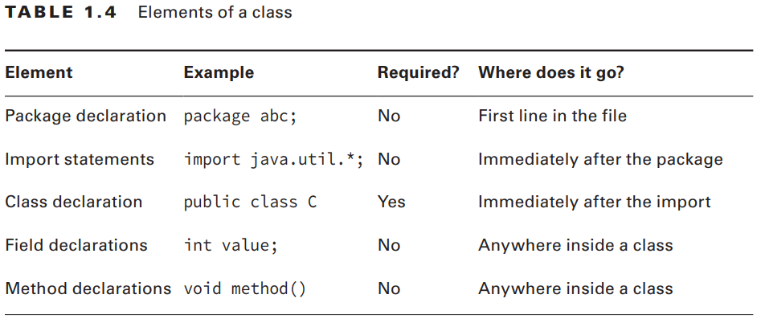
9-Ordering Elements in a Class

Slide 87
9-Ordering Elements in a Class
Let’s look at a few examples to help you remember this. The frst example contains one of each element: package structure; // package must be first non-comment import java.util.*; // import must come after package public class Meerkat { // then comes the class double weight; // fields and methods can go in either order public double getWeight() { return weight; } double height; // another field – they don't need to be together }

Slide 88
9-Ordering Elements in a Class
So far so good. This is a common pattern that you should be familiar with. How about this one? /* header */ package structure; // class Meerkat public class Meerkat { } Still good. We can put comments anywhere, and imports are optional.

Slide 89
9-Ordering Elements in a Class
In the next example, we have a problem: import java.util.*; package structure; // DOES NOT COMPILE String name; // DOES NOT COMPILE public class Meerkat { } There are two problems here. One is that the package and import statements are reversed. Though both are optional, package must come before import if present. The other issue is that a field attempts declaration outside a class. This is not allowed. Fields and methods must be within a class.

Slide 90
9-Ordering Elements in a Class
There are two problems here. One is that the package and import statements are reversed. Though both are optional, package must come before import if present. The other issue is that a field attempts declaration outside a class. This is not allowed. Fields and methods must be within a class. 1: public class Meerkat { } 2: class Paw { } A file is also allowed to have neither class be public. As long as there isn’t more than one public class in a file, it is okay. On the OCP exam, you’ll also need to understand inner classes, which are classes within a class.

Slide 91
10-Destroying Objects
10-1) Garbage Collection Now that we’ve played with our objects, it is time to put them away. Luckily, Java automatically takes care of that for you. Java provides a garbage collector to automatically look for objects that aren’t needed anymore. All Java objects are stored in your program memory’s heap. The heap, which is also referred to as the free store, represents a large pool of unused memory allocated to your Java application.
The heap may be quite large, depending on your environment, but there is always a limit to its size. If your program keeps instantiating objects and leaving them on the heap, eventually it will run out of memory. In the following sections, we’ll look at garbage collection and the finalize() method

Slide 92
10-Destroying Objects
10-1) Garbage Collection Garbage collection refers to the process of automatically freeing memory on the heap by deleting objects that are no longer reachable in your program. There are many different algorithms for garbage collection, but you don’t need to know any of them for the exam. You do need to know that System.gc() is not guaranteed to run, and you should be able to recognize when objects become eligible for garbage collection.

Slide 93
10-Destroying Objects
10-1) Garbage Collection Let’s start with the first one. Java provides a method called System.gc(). Now you might think from the name that this tells Java to run garbage collection. Nope! It meekly suggests that now might be a good time for Java to kick off a garbage collection run. Java is free to ignore the request.

Slide 94
10-Destroying Objects
10-1) Garbage Collection
The more interesting part of garbage collection is when the memory belonging to an object can be reclaimed. Java waits patiently until the code no longer needs that memory.
An object will remain on the heap until it is no longer reachable. An object is no longer reachable when one of two situations occurs: ■ The object no longer has any references pointing to it. ■ All references to the object have gone out of scope.

Slide 95
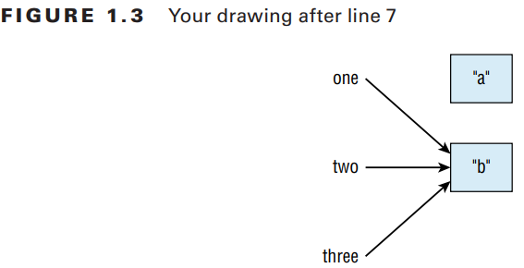
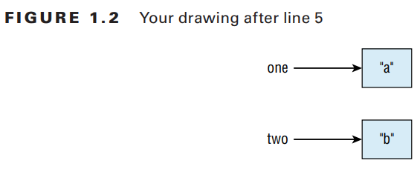
10-Destroying Objects
10-1) Garbage Collection
Look at this code and see if you can figure out when each object first becomes eligible for garbage collection: 1: public class Scope { 2: public static void main(String[] args) { 3: String one, two; 4: one = new String("a"); 5: two = new String("b"); 6: one = two; 7: String three = one; 8: one = null; 9: } }
Notes:
On line 6, we got rid of the only arrow pointing to "a", making that object eligible for garbage collection. "b" has arrows pointing to it until it goes out of scope. This means "b" doesn’t go out of scope until the end of the method on line 9.

Slide 96
10-Destroying Objects
10-2) finalize()
Java allows objects to implement a method called finalize() that might get called. This method gets called if the garbage collector tries to collect the object. If the garbage collector doesn’t run, the method doesn’t get called.
If the garbage collector fails to collect the object and tries to run it again later, the method doesn’t get called a second time. In practice, this means you are highly unlikely to use it in real projects. Luckily, there isn’t much to remember about finalize() for the exam.
Just keep in mind that it might not get called and that it definitely won’t be called twice.

